Slide 1

Genpact Confidential

Slide 2
Genpact - Insurance Practice
Risk, Actuarial &
Analytics
Producer Services
New Business & Underwriting
Policy Administration
Claims Management
Finance & Accounting
Technology Solutions
Actuarial
Reserving
Pricing
Catastrophe Modeling
Risk Management
Business Intelligence
Marketing Analytics
Agent Licensing
Agent Appointments
Commission Coding & Accounting
Record Maintenance
Termination Renewals
Application Submission
Risk Clearance & data Entry
Life Underwriting
General Insurance Underwriting-- CAT Pricing Quote Generation
Policy Issuance
Policy Review
Policy Maintenance
Customer Service
Cancellation and Reinstatements
Invoice Management
Premium Audit
Rate Filings
Notification of Loss
Document submission & Induction
Investigation & Evaluation
Claims Adjudication
Litigation & Settlement
Payment
Recovery & Close File
Daily Transactional Processing
Close Process: Reconciliations
External & Internal Reporting: Stat and GAAP Reporting
Decision Support
ERP Implementation
Data Warehousing
Application Development & Support
Database & Application Management
Infrastructure & Network Management
Capability Summary
End to End Presence: Cover all key process steps from Policy Set-up, Customer Service to Claims Management and General Accounting services, across Property, Whole Life, Term, Universal and Endowment products
Unique Value Adds - Unique, Proprietary SEPSM Methodology; Operating Innovation, Powered by Lean/Six Sigma; Deep, Process Level Expertise; Integrated Business Process Management - ITO Services
Range of Products - Include Life, LTC, Annuities, Healthcare, General Liability, Automobile, Commercial Property and Inland & Marine Aviation.
Delivering End to End Solutions For Insurance Businesses

Slide 3
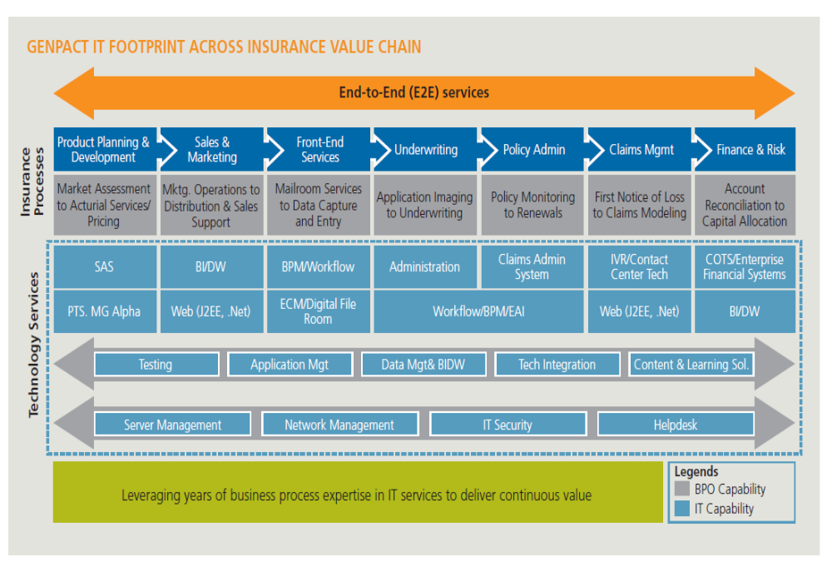
Genpact IT Footprint across Insurance Value Chain

Slide 4
Insurance Testing Overview
December, 2011
© 2009 Copyright Genpact. All trademarks appearing herein belong to their respective owners.

Slide 5

Insurance Testing Capabilities
Web Quote tools
Quote tools
New Biz applications
E2E Functional validations of New Biz processes
Policy Print Verifcitions
Policy print validations
Underwriting tools validations
Agent systems E2E validations
E2E Claims Functional validations
Data Capture
Claims Assessment
Pending Follow up
Claims Adjudication
E2E Policy Life Cycle functional Verifications
Financial and Non-Financial Transactions
Premium Accounting
Complex Policy Changes
Termination/ Cancellation
Contact Center
Customer intimations such as letters & emails
Validation of Client servicing satellite apps
Verification & validation of 3rd party interactions like L&A, Financial institutions, General Agents, etc
E2E validation of online policy servicing features across multiple lines of biz.
Validation of other agent servicing apps on the web across lines of Biz.
Operating Scale and Experience – Over 7+ year of experience providing testing services to insurance customer across Biz lines. Involved in Functional testing of NPI and other enhancements including state specific product launches.
End to End Domain Capability – E2E Testing Coverage from Policy initiation till claims including producer management & third party integrations from a domain & functional perspective
Unique Value Adds – Value adds provided by increased efficiency thru test automation thereby reducing test cycle time and increased speed to Market thru faster rollout of major NPI & enhancement
Automation Framework highly scalable thru technologies such as SOAP UI ensuring early detection of defects and thereby saving costs and
Additional Capabilities:
  Domain Knowledge ensures faster ramp up on new innovative products and quicker turn around on testing
  Document Management - E2E validation thru third party interface validation and automated verifications

Slide 6
Delivery Model & Coverage…
Long Term Care
Annuities
Life
Testing Footprint
Focus Areas
Delivering
Sales Tools
Domain Knowledge ramp up
Regression Test Bed Setup
E2E Regression Test execution
New Product Implementation
Enhancements & Change Requests
FTR > 95%
100% Test Requirement Coverage
> 95% Defect Free Releases - SLA
Consistent DRE 95% & Above
Looked upon as SME /Domain Expert
Agent App Tools
CRM – Sales force
Mature Model
New Biz Systems
Project Implementation Method
Automation Feasibility Study
> 80% Execution – Automated
< 10% Manual Execution
Maximize Leans thru Process improvements & Macros to reduce Cycle time
Speed to Market improved over 80%
Consistent ROI improvement over 1:10
Robust Automation Framework – Easy enhancements & Maintenance
Improved Cost Benefit Ration – YOY
SLA’s – DRE & FTR met consistently
Admin Systems
Print Validation
Policy Servicing
Claims
Results In
Quality Centre
Highly Satisfied & Happy Customer & Stakeholders
Excellent VOC’s for the Delivery Teams
Minimum10% Biz Growth YOY
2011 an exception with 45% Biz growth
Consistent & Growing annualized biz since past 6 years
IVR Testing
Web Services
2004 Revenues less than 100K →→→→→ 2011 Estimates @ USD 5.5 MM

Slide 7
Project Details & Testing Benefits
Genpact Testing Team is involved across Genworth R&P Biz predominantly helping the Biz Stakeholders ensure that the Release is bug free before moving into Production. Genpact teams are involved in UAT Design & Execution, Regression test bed design & automation.
Biz | Applications | Tools used | Benefits
Long Term Care | Sales & Quote Tools – Offline & Online New Business xPression CLOAS & SFDC Provence, Appdig, eprocess MDM, SMART Calypso | Genpact Testing Methodology & Framework Genpact Automation Framework Quality Centre QTP Paloma & Macros | Project per release more than double in the last couple 2 years Defect Detection early in the cycle thru 100% automated regression suite Mainframe automation using QTP scripts – Speed to Mkt. Robust reusable automation framework – useful for functional automation script development ROI delivered more than 8 MM in H1 2010
Annuities | R&P Web Applications Consumer Web Genwoth,com Intranet ANB & eProcess Workflow systems Group VA, Ingenium Admin Server Clear course ANB SPIA & SPDA STP funds transfer | Genpact Testing Methodology & Framework Genpact Automation Framework Test Director – Rational Quality Centre QTP SOAP UI – Web Services Testing | Consistent YOY DRE above 95% FTR above 95% YOY 100% automated Regression bed Functional Automation 50% and in Progress E2E automation – increased speed to Market ROI delivered more than 1.6 MM in H1 2010.
Life | Policy Print & Validation Fulfillment – LQR Fulfillment – ILQR Fulfillment – App Upload | Genpact Testing Methodology & Framework Genpact Automation Framework Quality Centre QTP & Macros | Over 4+ years of Print Validation experience and team brings in an SME perspective Automated illustration validation using Macros – improved speed to Market Created automation regression test bed on the fulfillment project in the first year – improved speed to Market ROI Line of Sight of 700K in the first year of fulfillment engagements Functional automation in progress across fulfillment projects improving ROI
ROI Delivered thru continuous improvement measures using Lean projects for Process improvements and continuous functional automation & regression automation builds reducing testing timelines & improving speed to market.

Slide 8
Health Slides
© 2009 Copyright Genpact. All trademarks appearing herein belong to their respective owners.

Slide 9
IT Services - Value Proposition & Frameworks
- Focus on Domain & Business Outcomes, Process Excellence
Services | Value Proposition | Frameworks
Process Consulting – IT & Process Combined | Process Consulting experience of over 120 high impact projects across industries 90% repeat business | Process Re-engineering Methodology Lean, Six Sigma
Strategic Assessments & PMO | Large Global program management experience – 8 years Re-engineering IT systems to Best In Class across different large environments | Program Management methodology Application Rationalization framework EHI benchmarks
Application Maintenance Support and Testing | 20%-30% AMS spend reduction, Upfront YoY productivity 30%-40% reduction in Avg. Daily Incident Inflow Rate (ADIR) over 3 years 99% defect free transition and stable AMS service delivery | Differentiated SLAs: ADIR, Production Schedule Attainment (PSA) Outcome based pricing models: SLA based - Fixed fee, transaction and business outcome based Agile based CMMI

Slide 10
Genpact IT Capabilities – Application Development & Maintenance
Software Solutions Capabilities
Industry
Verticals
BFSI
Manufacturing
Service Based Industries
Enterprise services aligned by industries
Business Case Dev/
Project Planning
Process Design/
Re- engineering
Enterprise Solution Implementation & Enhancements
Software Assurance,
Testing & Global
Roll outs
App Maintenance
& Enhancement Services
Service Offerings
Enterprise solution value assessment
Business case development
Enterprise Solution implementation roadmap / methodology deployment
Project planning, resourcing
‘As Is’ business process analysis
‘To be’ business process design by key business flows
Global Enterprise Solution Design & Build standards & processes
Instance configuration & change mgt.
Custom design & build
Enterprise Solution technical architecture & integration strategy
3rd Party Application assessment
Functional manual and automated testing
Load & Integration Volume testing
Performance testing
Global Roll-out standardization
Business process simplification, automation and enhancement
Application upgrade
SLA based configuration & maintenance
Performance optimization
Enterprise Applications Oracle, SAP, Siebel, PeopleSoft
Technology Platforms
Business Intelligence & Enterprise DW Oracle Discoverer, Hyperion, Business Objects, Cognos, Informatica
Technology Integration & Development Microsoft, Java, J2EE, Oracle, Mainframe/ Legacy Systems
SOA (BPM, EAI & BAM) Oracle Fusion, IBM, WebMethods, TIBCO, Savvion, Filenet
Testing Solutions (Manual & Auto) Mercury, Borland, Other
Program Management PMO start-up, Resourcing, Vendor Management, Global Program KM, Pilot & Global Roll-out strategies

Slide 11
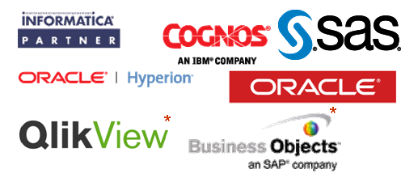
Genpact IT - Business Intelligence / Analytical Support
Practice founded in 2000
800+ BI/DW & Analytics consultants worldwide; 20% Certified
Over 35,000 users supported world wide
90% Projects delivered On time and within budget
Typical 20-30 % savings on Fixed price projects
Partnerships & Certifications
Consulting Services
Implementation Services
Analytics & Research Services
BI Assessment
Master Data Management (MDM)
Data Quality/Governance
Corporate Performance Management
Enterprise Performance Management (EPM) and Financial Planning & Budgeting
Data Modeling & Data Quality Build
EDW Build & Support
Business Intelligence Reporting
Corporate Performance Management Build – Dashboards & Scorecards
EPM and Financial Planning & Budgeting
Master Data Management Build
DW & Reporting Testing
Marketing Analytics
Clinical Analytics
Sales Analytics
Customer Segmentation
Pricing Analytics
Market Research
Risk Analytics
HR Analytics
Genpact placed as Leaders in AMR Research Institute In BI, DW + Analytic Services
© 2011 Copyright Genpact. All Rights Reserved.

Slide 12
Testing Practice
Testing Centre of Excellence
Domain Expertise & Technologies
Process , Methodologies & Tools
Specialized Offerings
Service Offering
System Testing
System Integration Testing
User Acceptance Testing
Regression Testing
Load, Volume and Stress Testing
Application Monitoring Testing
PPM Services
SQA
Financials (Banking, Insurance)
Manufacturing
Health Care
Technologies Services
SAP, Oracle ERP
Legacy Applications
Siebel
Web (j2EE, .NET)
CMMI level 5 Process
Six Sigma, Lean
Quality, Project & Knowledge Management
HP Quality Center, QTP, Win runner and Compuware Tools
Load Runner, Performance Center, HP Diagnostics
HP Business Availability Center, HP Site scope, HP Open view –
Framework - BPT , Turnkey, GENPACT Framework
ERP Automation Testing
Product Testing
Data Base Testing / BI Testing
Web services Testing
SOA Testing
Mainframe Macro Testing
Performance Diagnostics (Oracle ERP,j2EE,Siebel)
Performance Management
PPM - Impl/Supp/Upgrade
UCMDB
Key Highlights
Practice founded in 2004; 180+ dedicated technical applications and certification across different Domains
Comprehensive Training & Certification experts.
Rich Industry Expertise over Program – 100% Internal Certified Test Engineers
Consistent Defect Removal efficiency ~DRE 97% - Zero defect releases.
Unique internal automation framework - 40% component reusability and Reduced Manual effort by 50%
Performed over 6000 Performance Tests in last 4 years -Detected 9000 defects savings $ 9 Million
“Overall customer Satisfaction” rating >4.8 in a 5 Point scale.
End to End Testing Solutions - Better, Cheaper & Faster

Slide 13

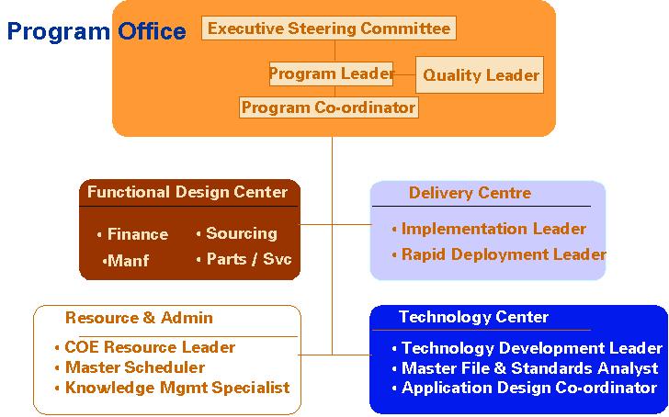
Program Management: Core Capability
Vision
Program Management Framework
Program Management
TG1
TG2
TG3
TG4
TG5
Program Planning
Strategy
Program
Implementation Support Service
Transition/ App Mgmt
Master Scheduling
Knowledge Base and IM Portal
Global Design and Standardization
Software
Quality – Six-Sigma and SQA
Vendor
1
Vendor
3
Execution Organization Structure
Vendor
2
Scope:
Synchronization between the India entities
Standardization & Simplification
Best Practice sharing and deployment
Driving consistent methodology & training
GE DNA - incubated primarily for Offshore Program Mgmt

Slide 14
SAP Slides
© 2009 Copyright Genpact. All trademarks appearing herein belong to their respective owners.

Slide 15

Genpact SAP Global Practice
Global
SAP Centre of Excellence setup in 2004
Acquired ICE Consulting Services based out of Europe in 2007
Over 800 SAP professionals engaged in North America, Europe, China and Asia Pacific
60% > 5 years of Industry experience
Over 1+ million days of SAP consulting experience
Support 20,000+ Users
250+ Go-lives in 40+ countries on 20+ Production Environments
24x7 SAP Maintenance & Enhancement capabilities
Full life-cycle capabilities for SAP Implementations and Upgrades
Genpact Netherlands
ICE Consulting Services founded in 1999
Acquired by Genpact in 2007
Around 150 SAP professionals
Avg. years of SAP experience > 8 years
Sector Experience on Utilities, BFSI and Manufacturing
Business Experience on Financials, ERP (all modules), Business Intelligence, Performance Management (consolidation/business planning)
35+ SAP FS CD, CM, PM consultants
60+ SAP BW, EPM and Business Objects consultants, including Oracle expertise
30+ Go-lives with SAP BW, SEM and EPM
Full life-cycle capabilities for SAP Implementations and Upgrades

Slide 16
SAP Capabilities Overview
Industries
Engineering
Oil & Gas
Life Sciences
Financial Services
Banking
Insurance
Financial Services
Service Based
Industries
Media
Utilities
Manufacturing
Chemical
Hitech
Auto
‘Sales / Services’ Side
‘In’ side
‘Buy’ side
CRM
Customer Service
SAP Sales and Distribution
SAP Financials
SAP Controlling
SAP Manufacturing
SAP MM/WM/QM
SAP HR
SAP PLM
SAP MM Procurement
SAP SRM
SAP Business Intelligence, SEM, Business Objects & EPM Solutions
SAP Netweaver Stack (ABAP, Java, EP, XI/PI and MDM)
SAP Automated Testing and Training
Database & System Administration
SAP Industry Solutions – IS-Utilities, SAP Insurance (PM, ICM, CD, Claims)
Program Management Office, SAP Center of Excellence Start-up & Run
ERP
STRATEGY
DESIGN
BUILD
RUN &
UPGRADE

Slide 17
Services - Value Proposition & Frameworks
- Focus on Domain & Business Outcomes, Process Excellence
Services | Value Proposition | Frameworks
Process Consulting | Process Consulting experience of over 120 high impact projects across industries 90% repeat business | Process Re-engineering Methodology Lean, Six Sigma
Strategic Assessments & PMO | Large Global program management experience Re-engineering ERP systems to Best In Class | Program Management methodology Application Rationalization framework
Design, Implementation and Global Rollout | Business Outcome focus: 50% financial closing cycle time reduction, 30% inventory reduction 20%-30% Faster rollouts 90% Fixed fee engagements 95% on time, on budget | Accelerators for rapid deployment (20%-30% cost reduction)
Application Maintenance Support | 20%-30% AMS spend reduction, Upfront YoY productivity 30%-40% reduction in Avg. Daily Incident Inflow Rate (ADIR) over 3 years 99% defect free transition and stable AMS service delivery | RCCA Differentiated SLAs: ADIR, Production Schedule Attainment (PSA) Outcome based pricing models: SLA based - Fixed fee, transaction and business outcome based
Upgrade - Technical and Functional | 25%-30% upgrade cost reduction Reduced risk, improved predictability in customized environments | GenLeanSM – Rapid SAP upgrade framework

Slide 18


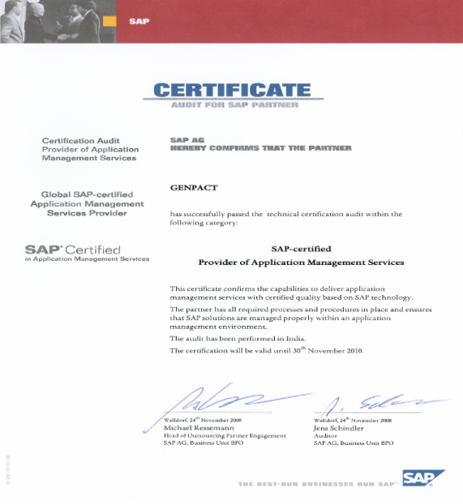
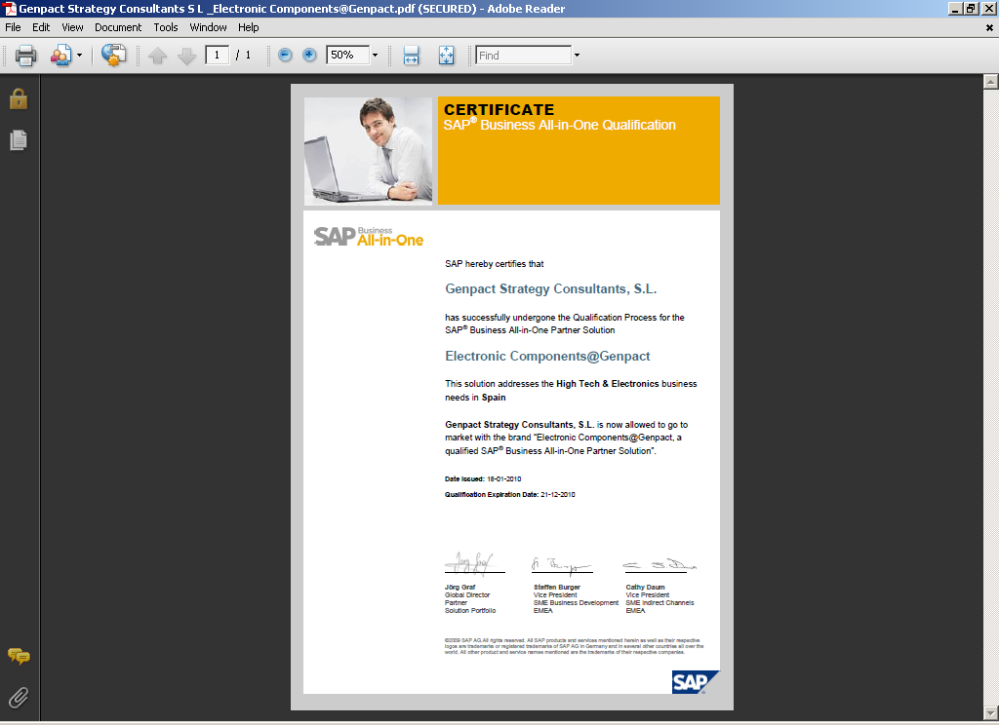

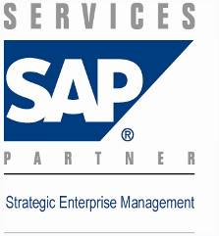



SAP Partnership
SAP Services partnership for US, Europe, China and India
SAP Vertical Expertise Partner for Financial Services
SAP License resellers for Europe
SAP Certified Global AMS Services Provider
  The 1st Indian partner out of a total 16 globally
SAP Certified Solution Provider for Electronic Components Manufacturing
SAP BW / SEM and BOBJ Partner
SAP IS-U (Utilities) Partner
Active Member of ASUG and VSNG

Slide 19

Position of Genpact for SAP core insurance & back-end systems
Analytics
SEM
Business Consolidation System
SEM
Business Planning Simulation
Business Warehouse
Marketing & Sales
Insurance Core System
Business Support
FS-PM
Policy Management
FS-CM
Claims Management
HCM & CATS
msg.PM
Product Manager
FI/CO/AM
Accounting
CRM system
2011
Material Management
FS-CD
Collections & Disbursement
Project System
Broker Account
FS-ICM
Incentive and Commission Management
Supplier Relationship
Management
2011
Business Partner Management
Netweaver
v
Identity
Management
v
Governance, Risk
and Compliance
Process
Integration
Portal
Business Process
Management*
* SAP Workflow only
Genpact NL Project Management and/or Senior consultants
Opportunities – matches Genpact NL’s skill sets

Slide 20



Solution Accelerators
- Reduce Cost, Cycle Time of ERP Initiatives
Implementation Lifecycle
Project Initiation
Analysis & Process Design
Biz Solution
& System Design
Build & Test
Cutover &
Go live
Production & Steady State
Change Acceleration Process (CAP)
Early change adoption
Implementation Methodology
20%-30% cost reduction
Productized ERP eLearning Content Dev
20%-25% training cost reduction
Rapid ERP Upgrade Solution
25%-30% cycle time & cost reduction
30%-40% testing cycle
time reduction
Automated Test Case Library
100% fail-safe and automated change management
Release Manager
ERP AMS
Transition & Run
Methodology (FRAMES)
99% defect free transitions

Slide 21





Genpact Global Implementation Methodology
Global Program
Preparation
Global Business
Blueprint
Global
Realization
Pilot Site
Final
Preparation
Pilot Site
Go Live &
Support
Program Strategic Framework and Business Case Program and Project Management Six Sigma Tollgate Approach Implementation Program Standards Business Scenario and Process Inventory Organization Change Management (OCM) strategy Lifecycle Data Management approach Global Technical Infrastructure Planning Training Plans Customer COE | Enterprise Risk Management Planning OCM during Blueprinting Project Team Training Process Excellence Industry Best Practices Detailed Business Process Requirements Process Simplification and Consolidation Business Requirement Scenarios Organization Structure Master Data Business Scenarios Domain Expertise Industry specific requirements Conference Room Pilot Solution Architecture and Design Review Data Cleansing Procedures and Data Conversion Requirements User Authorization Requirements and Role Definition End user training strategy COE Implementation Plan | OCM during Realization. Training and Documentation Plan Technical Infrastructure Management and Global System Management Procedures Test Planning (Integration and Performance) Global Template Configuration and Developments Data Conversion Programs and Cleansed Data Data Archiving Strategy Preliminary Cutover Planning Role and Authorizations Creation Rollout Package Development Roll Out Strategy | OCM during Final Preparation. End User Training Customer COE readiness check Production Software loaded Cutover to Production Enterprise Risk Management SAP Solution Manager Optimization SAP Operations Readiness Assessment | System Support Business Support SAP Going Live Check Global Template update Rollout Package update
A comprehensive methodology based on SAP’s “ASAP approach” augmented by Genpact’s DNA in SEPSM, Lean Six Sigma and Domain Expertise

Slide 22








‘Blueprinting’: Where Business & IT Goals Come Together
Client
Business Resources
IT Resources
Genpact
SAP experts
SEPSM process experts
Re-engineering experts
As Is State
Client Processes
Knowledge Inputs
Design
ECC 6.0
SAP Standard
ECC 6.0
Process Best Practices
Insurance Best Practices
Genpact Process Knowledge
Work
Best
Best
Design
SEPSM Process
Excellence
Practices +
Sessions
Practices +
Work
Accelerators
Accelerators
New Ideas
New Ideas
IT Architecture
To Be
Blueprint
Blueprint
Live design - walkthrough in
sandbox system makes it real
Process and
System
Design
Documents
Documents
Documents
Optimal
Design
Optimal
Design
Deliverable:
Proof of concept
Optimal Design
Deliverable: Blueprint
SEPSM Process, SAP and Re-engineering Expertise are Key Elements to an Optimal Design

Slide 23
Case Study: Insurance + F&A
The Client
Approach and Execution
European Insurance major
Focused project team set up with the right assignment of responsibilities
  Project lead for business functional resources
  Project lead for data conversion efforts
  Project lead for IT
Review and improvement of existing business processes as integral part of design
Design and Configuration of IT solution
Testing
Went live June 2008
Continued support by people who moved from project team into SAP Competency Center
Situation
Acquired another insurance company
Had to work with multiple consolidation systems to close 280 legal entities in total
Business Need
One uniform set of business processes for consolidation
One system to support the financial processes
One system to generate internal and external (financial) reports.
Business Value Delivered
Reduced time to close books with ~30% and moving toward 60% reduction in 2010/11
Improved financial processes
One version of the truth
Future proof solution (able to handle emerging changes in business and regulatory environment)
IT cost reduction ~500k$/yr
Scope of Project
Business Process Improvement (e.g. reduce time to close books)
Implementation of
  SAP BCS (Business Consolidation)
  SAP BI (Reporting)
Migration (from Hyperion to SAP)

Slide 24
Case Study: Insurance + Financial Reporting with SAP BO
The Client
Approach and Execution
European Insurance major
For the execution of the project, the SCRUM-methodology is used. Via short sprints (3 weeks), reports are being produced and made available on the productive system.
Focused project team with both IT and Business combined.
Responsible for the execution of the sprints in the role of scrum master.
Provide One Version of the Truth by ensuring a stable/integrated SAP architecture as basis for the SAP BO reports.
Situation
Ambition of Group Reporting to become Leading in Finance in 2013 as part of their business plan.
Had to work with multiple financial departments throughout the group and divisions
Business Need
Need for a central reporting portal for both internal- as well as external financial reporting,
Need for ONE central database with all financial information, leading to One version of the Truth,
Uniform reporting standard throughout the whole group.
Business Value Delivered
Reduced time to produce reports with ~30% and moving toward 50% reduction in 2012. This by using reporting standards and information push as oppose to pull mechanism,
Improved financial reporting quality,
One Version of the Truth
Future proof solution,
Scope of Project
Generation of a central reporting portal with a standard reporting format for Group Finance,
Implementation of SAP BO 4.0 as part of a SAP ramp up program,
Generation of Dashboards, Detailed reports and analysis reports for both internal- as well as external reporting purposes for both the Group and Divisions,
Providing reports via new media like IPADs.

Slide 25
Case Study: Insurance – Broker Collection and disbursement
The Client
Approach and Execution
European Insurance major; Broker Collection dept.
Redesigned collection processes in conjunction with broker collection teams and financial department
Upgraded SAP landscape to ECC 6.0 EHP4
Designed and created universal data delivery tool for legacy policy administration to SAP FS-CD
Enabled processing volume of 400,000 collections/disbursements per month
Created 3 levels of training materials for general SAP, SAP FS-CD, SAP FS-CD broker collection and SAP FS-CD customising and SAP technical skills
Conducted training for 45 members of client staff
Situation
Complex system landscape for collections and disbursements resulting in high TCO and FTE
Multiple broker collection processes in use with too much deviations.
Business Need
Standardized collection processes to reduce complexity and unclarity
One system to support for collection and disbursements
Enable collection teams to serve multiple division to increase efficiency
Business Value Delivered
Decreased FTE in Broker collection teams ~ 20%
Reduced TCO of system landscape by decommissioning of legacy systems
Reduced arrears at Brokers due to increased financial visibility and interest calculation for outstanding arrears
Reduced time to close after financial month end
Provided option to merge broker collection teams into one team in the future
Scope of Project
Implementation of standardized collection processes
Implementation of SAP FS-CD (Collection and Disbursements)
Connection of policy admin systems to SAP FS-CD
Migration of transactional data from legacy systems to SAP FS-CD

Slide 26
Case Study: Insurance – Collection and disbursement
The Client
Approach and Execution
European Insurance major; central Collection dept.
Redesigned collection processes in conjunction with collection teams and divisions
Optimized implementation methodology to enable multiple implementations simultaneously:
  Execution of a profound analysis phase to ensure that all all requirements are discovered beforehand; this to avoid surprises during implementation
  Standard template for configuration in SAP FS-CD and related systems
  Standardized migration methodology and toolkit for migration and validation of data
Implementations completed for Health, P&C, Social Security and life products; in total >6,5mln policy holders
Situation
Complex system landscape for collections and disbursements resulting in high TCO and FTE
Multiple collection processes in use with too much deviations; dedicated collection teams for each division
Business Need
Standardized collection processes to reduce complexity and improve process TCO and outcome
One system to support for collection and disbursements
Enable collection teams to serve multiple division to increase efficiency
Business Value Delivered
Decreased FTE in collection teams
Reduced IT costs by decommissioning of legacy systems
Increased service levels to divisions and customers
Reduced DSO of outstanding receivables; increased collection rates
Scope of Project
Implementation of standardized collection processes
Implementation of SAP FS-CD (Collection and Disbursements)
Connection of policy admin systems to SAP FS-CD
Migration of transactional data from legacy systems to SAP FS-CD

Slide 27
Thank You
www.genpact.com
© 2009 Copyright Genpact. All trademarks appearing herein belong to their respective owners.

